Slide 1
Hackathon- Team 1
To get 5 names and address of Car Service centres near me which has more than 4* rating and above 20 customer reviews using Justdail.com

Slide 2
Team Members:- Adrija Banerjee(848855) Sayantan Dey(848844) Aishwarya Priya(848840) Ashwani Kumar Shaw(848850) Krittika Bepari(848853)

Slide 3

Automation Scripts
Automation Tools
Utilities

Slide 4
Automation Scripts
GetTitle.java
LocationSet.java
Configuration.properties
DriverSetup.java
Rating.java
WeblinkOpen.java
Search.java
SelectData.java

Slide 5
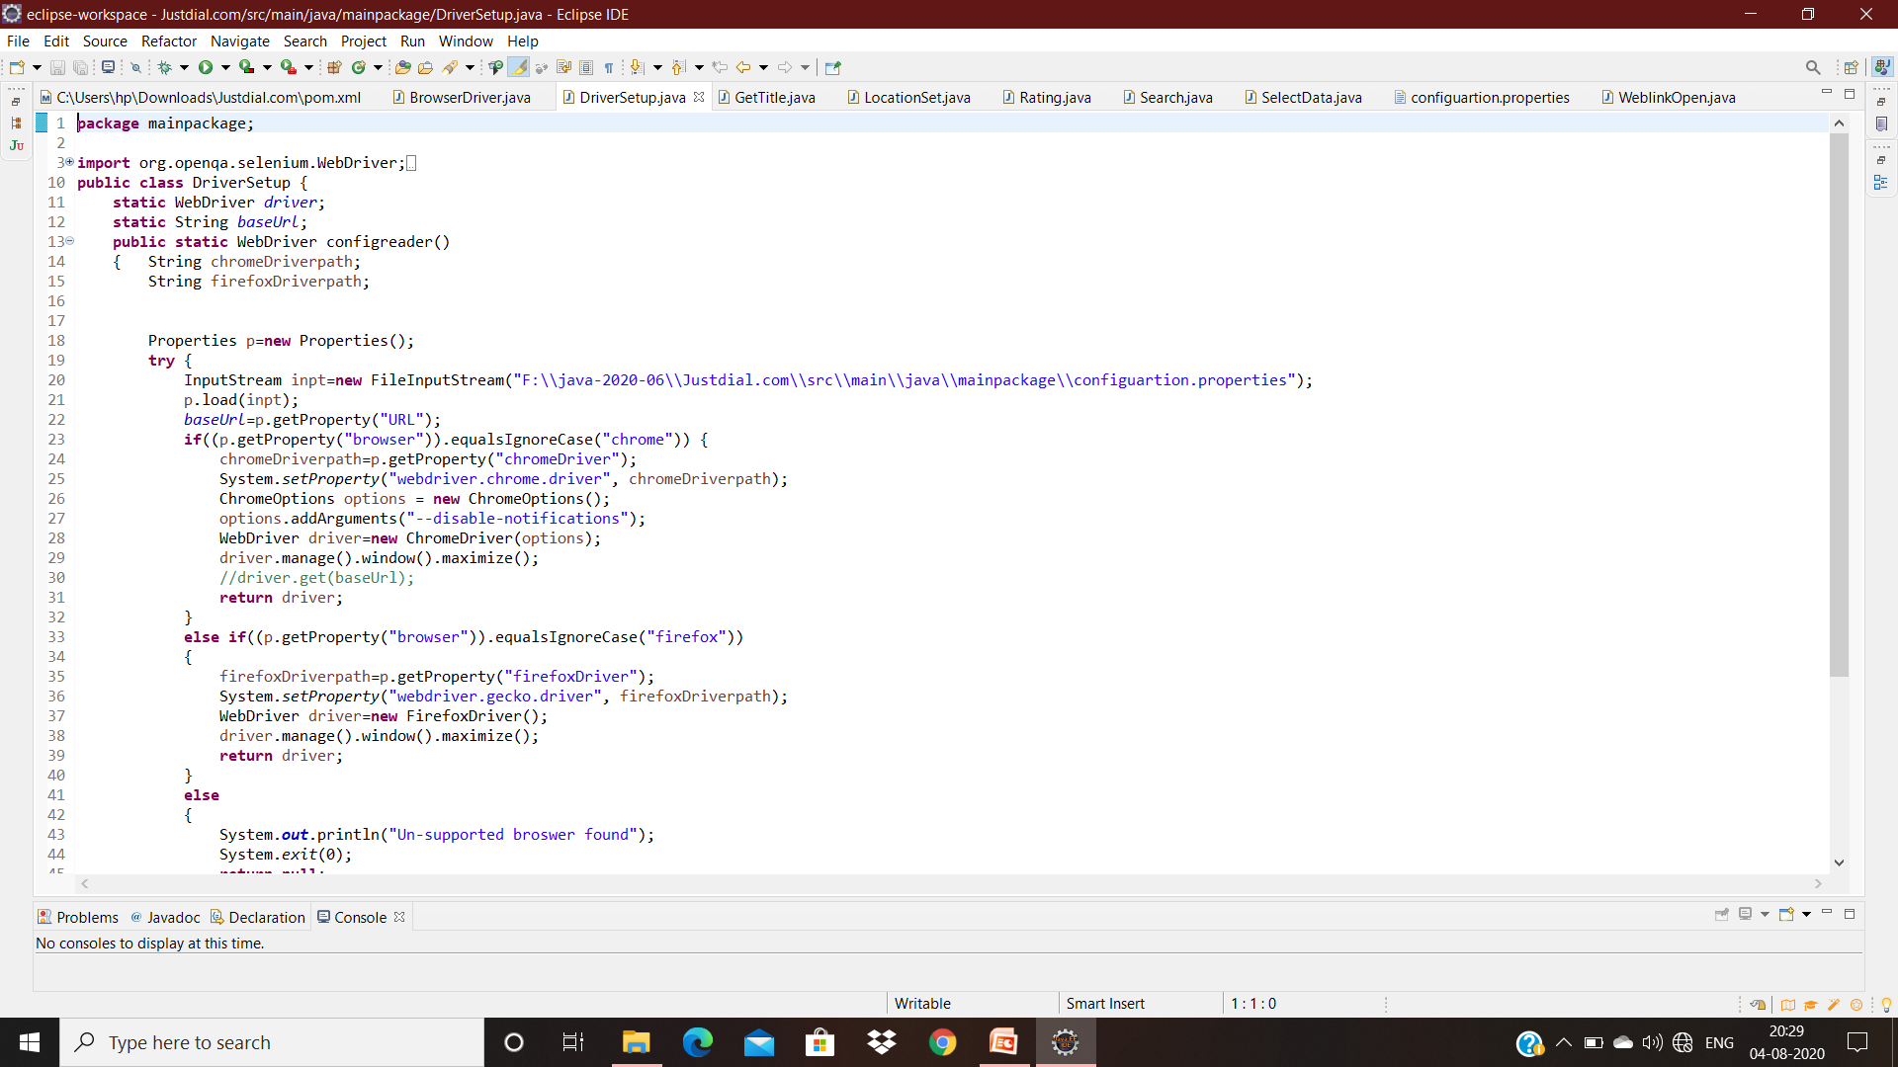
DriverSetup.java

Slide 6
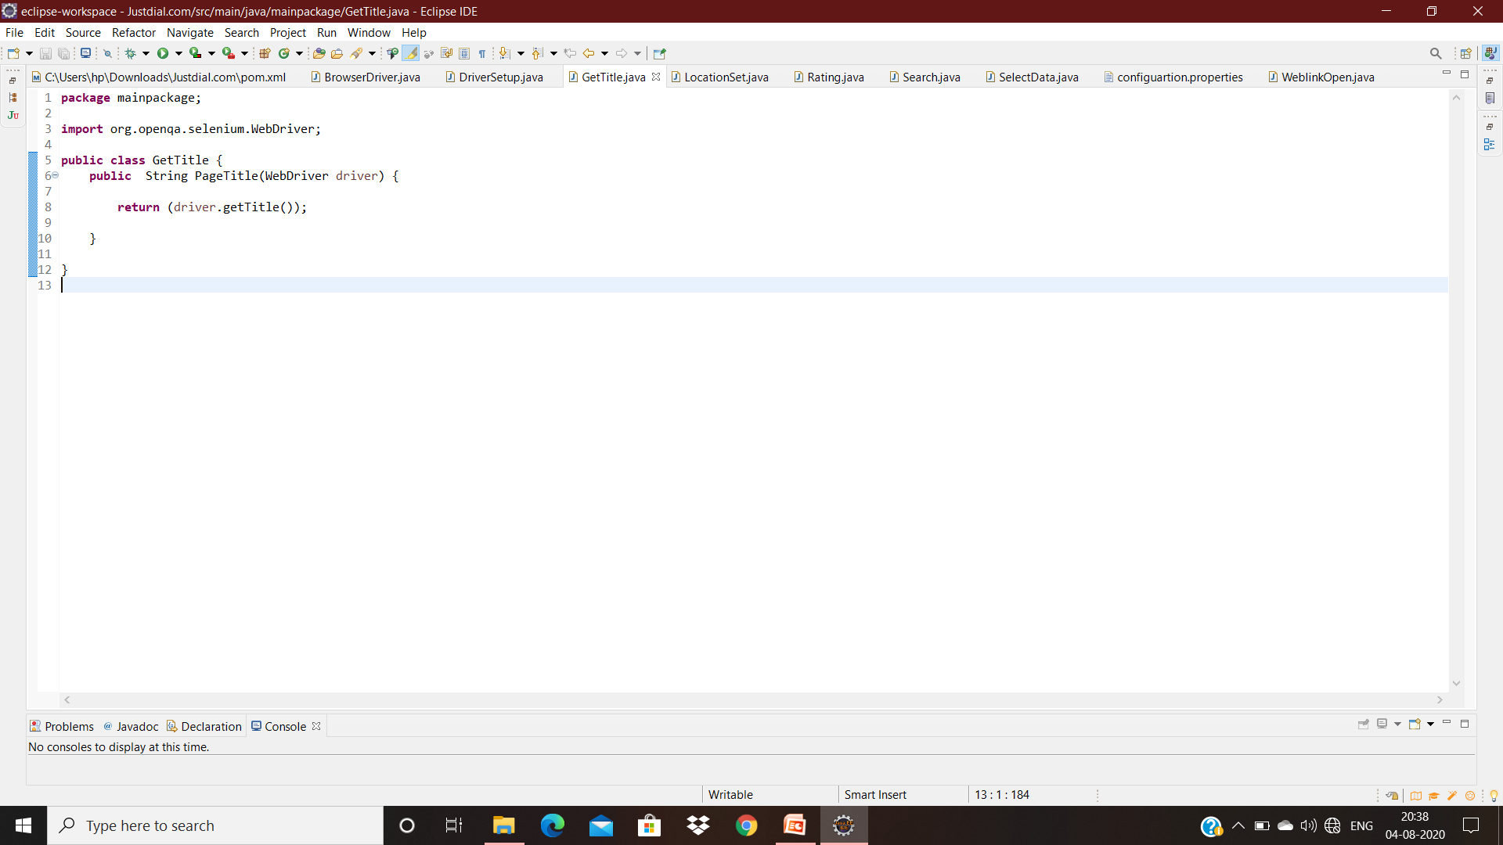
GetTitle.java

Slide 7
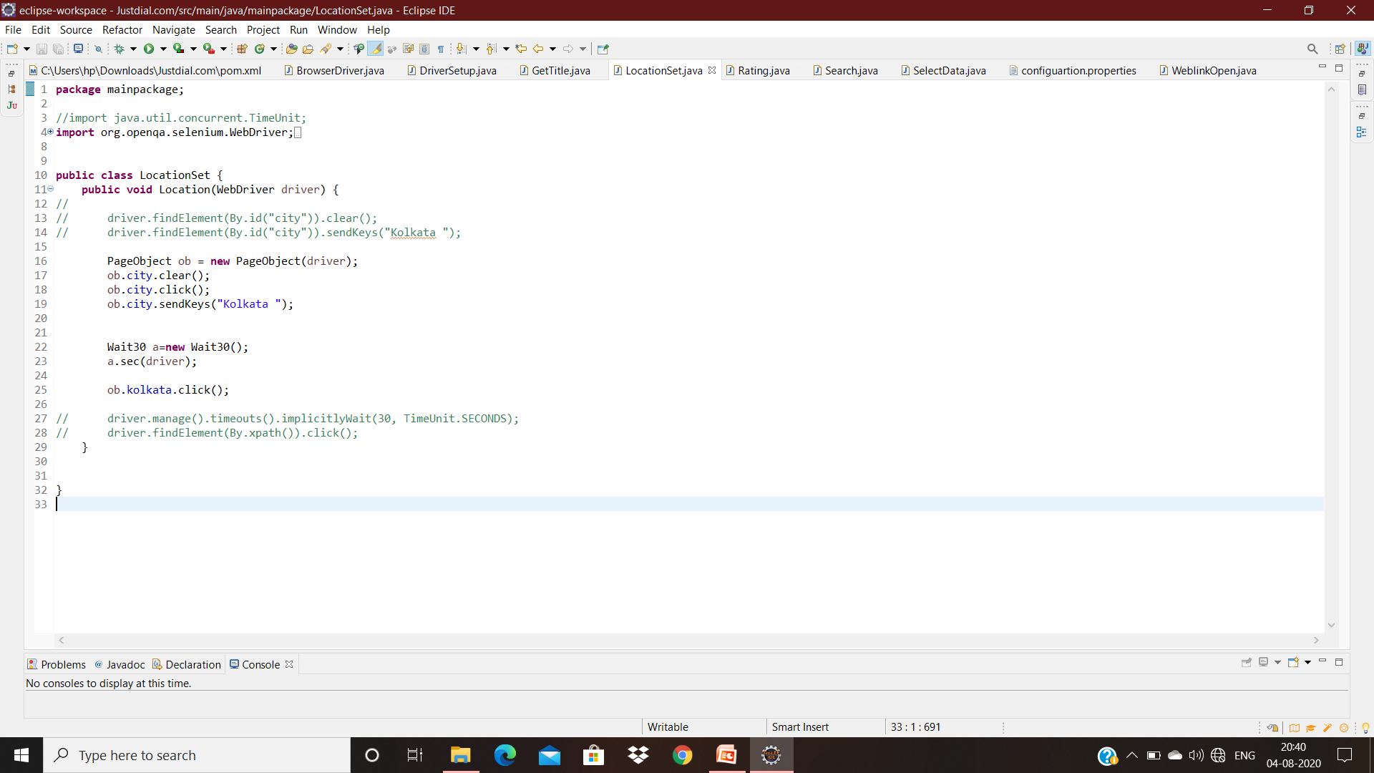
LocationSet.java

Slide 8
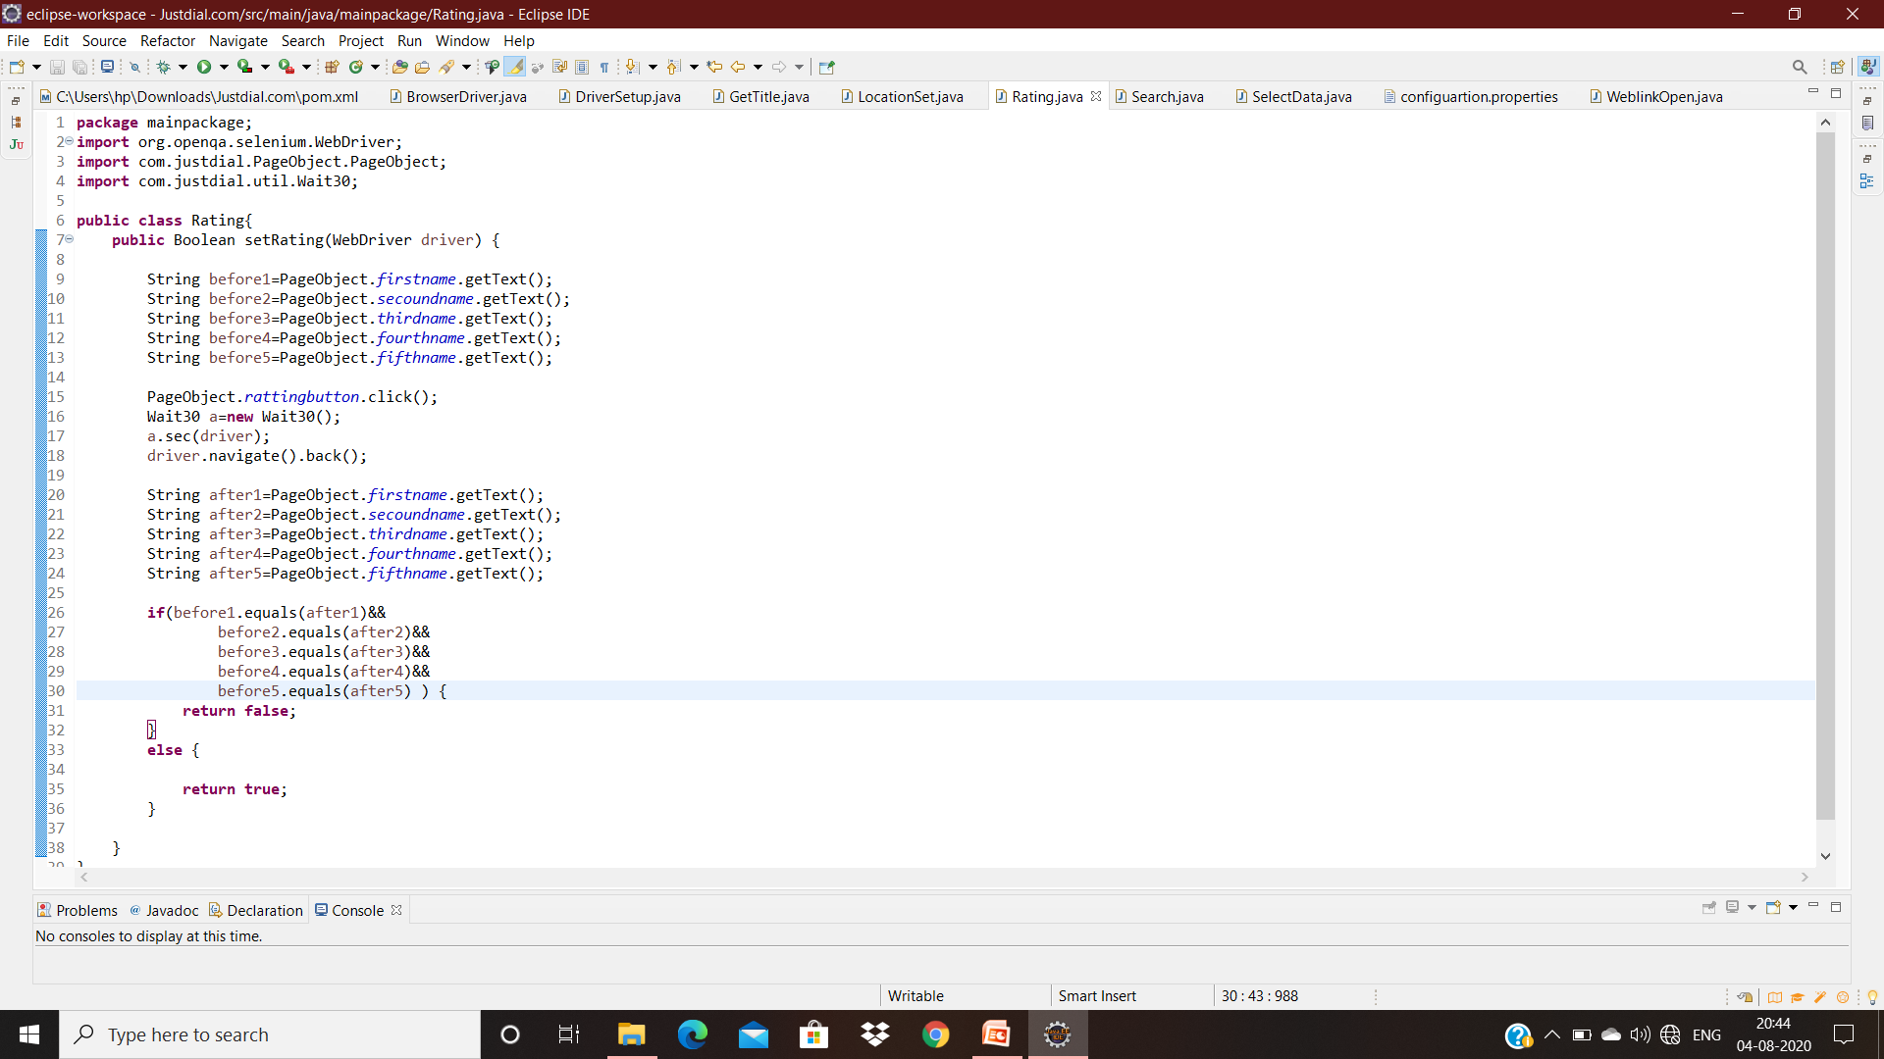
Rating.java

Slide 9
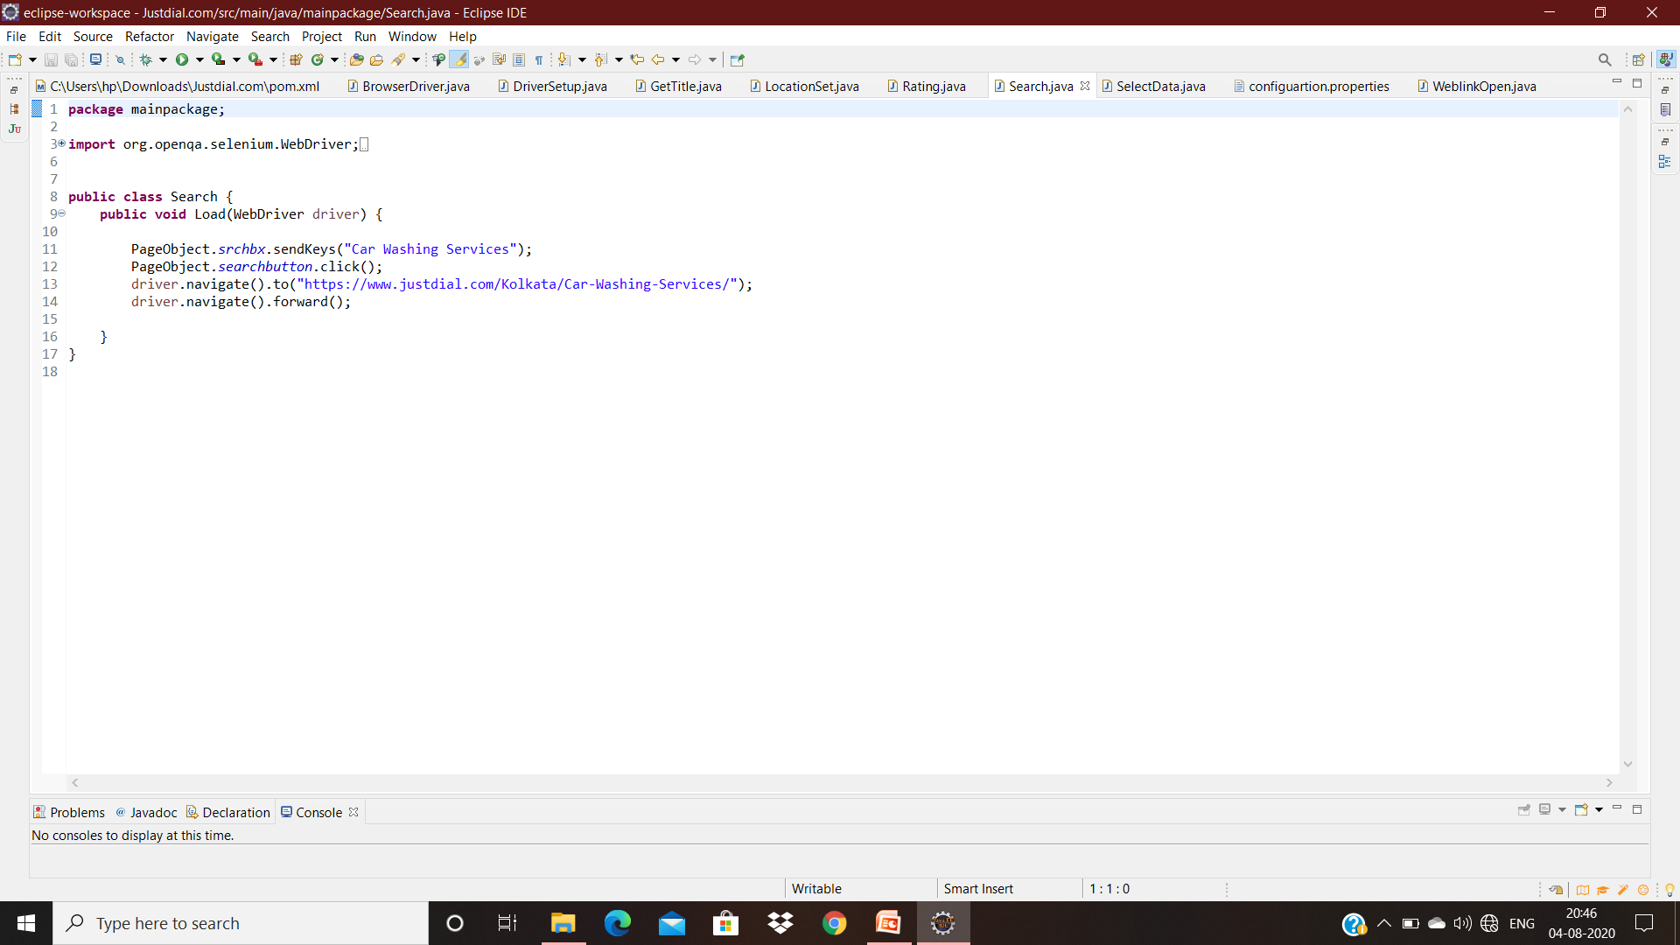
Search.java

Slide 10
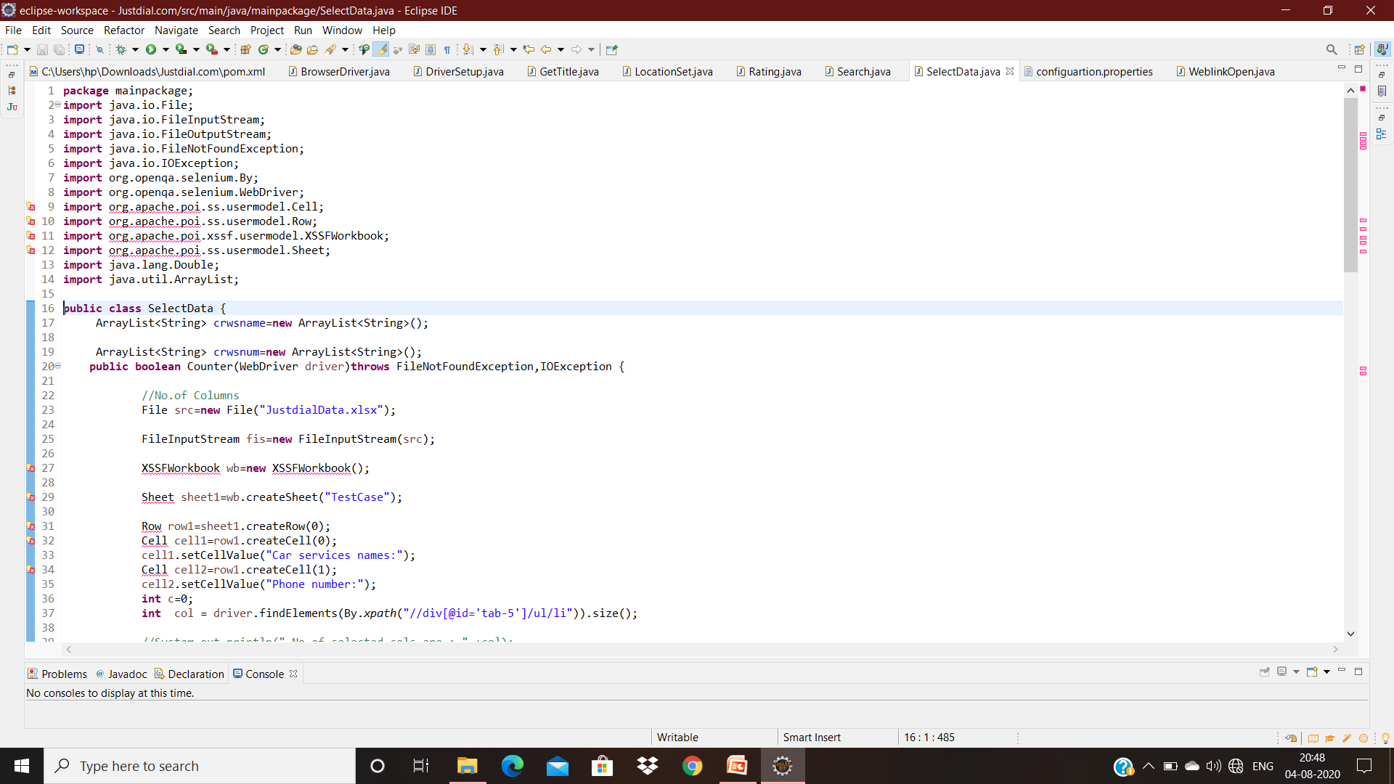
SelectData.java

Slide 11
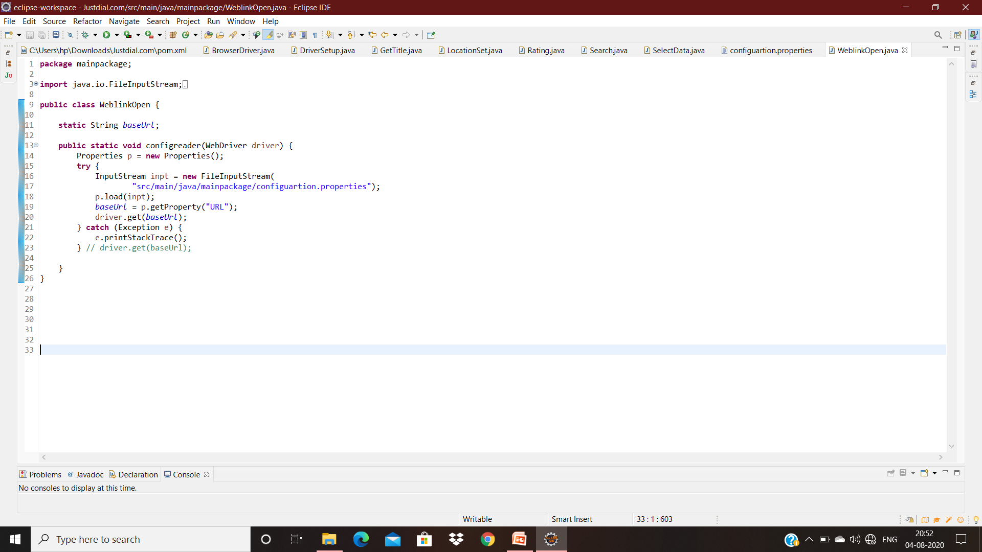
WeblinkOpen.java

Slide 12
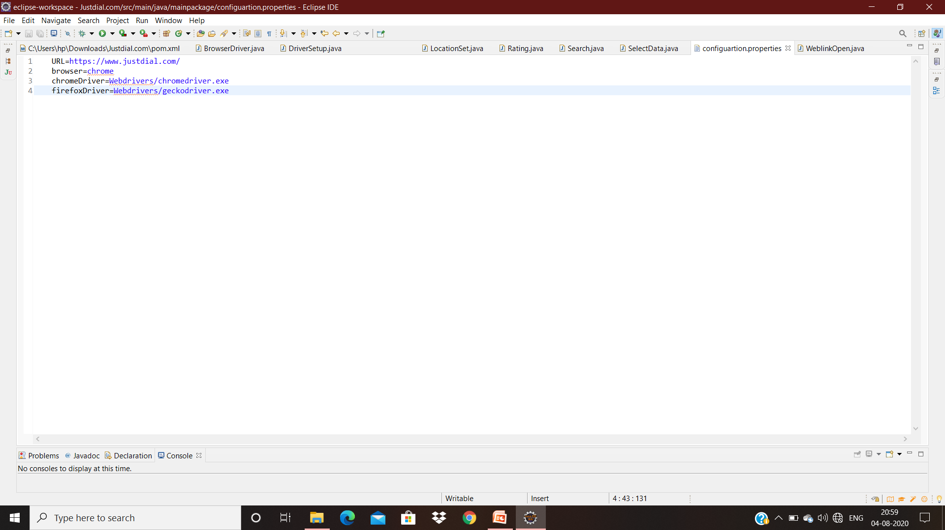
Configuration.properties

Slide 13
Automation Tools
Maven
Jenkins
TestNG
Logger
Grid
Notes:
Maven
Jenkins
Grid
TestNG

Slide 14
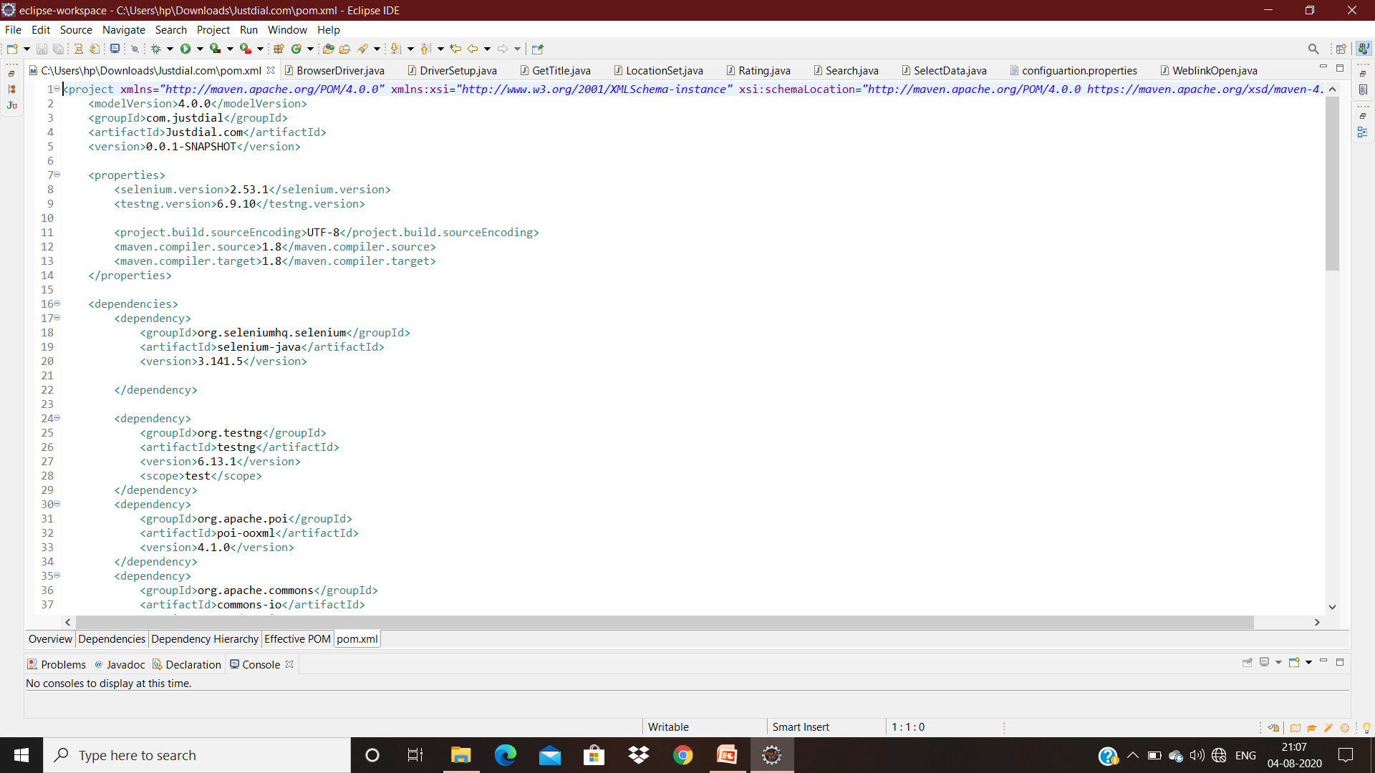
Maven

Slide 15
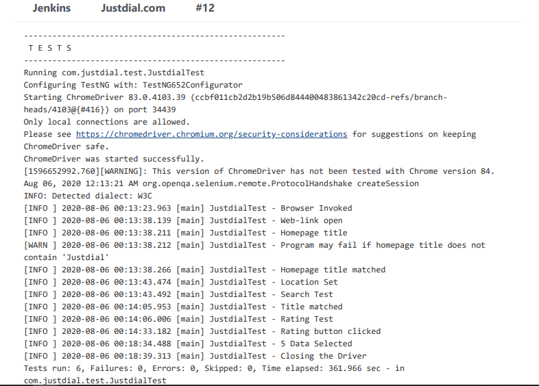
Jenkins

Slide 16
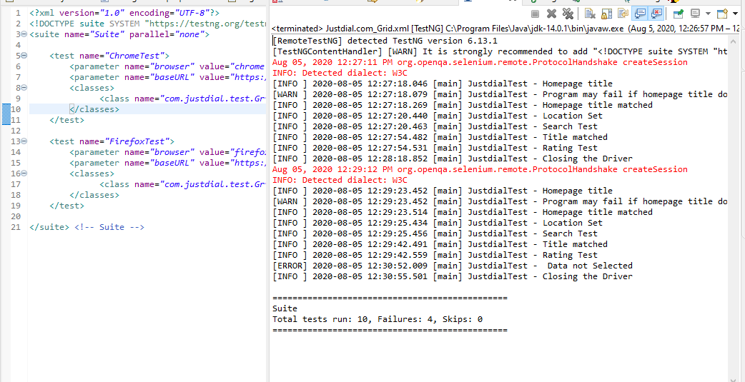
Grid

Slide 17
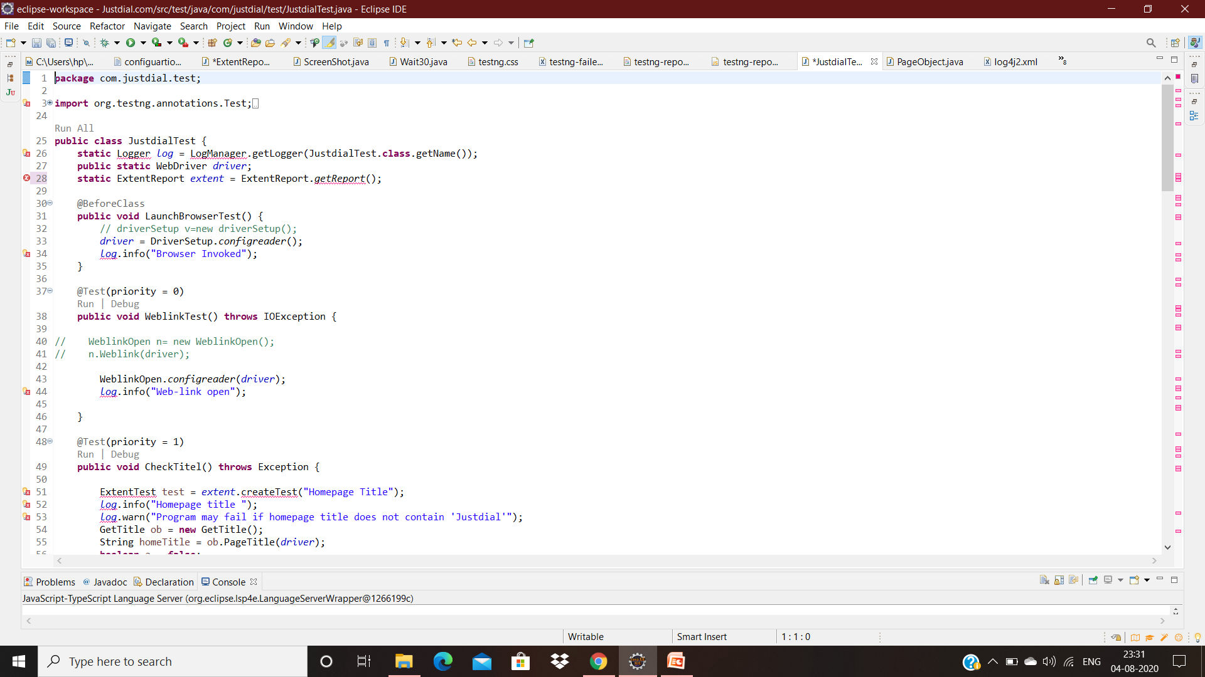
TestNG

Slide 18
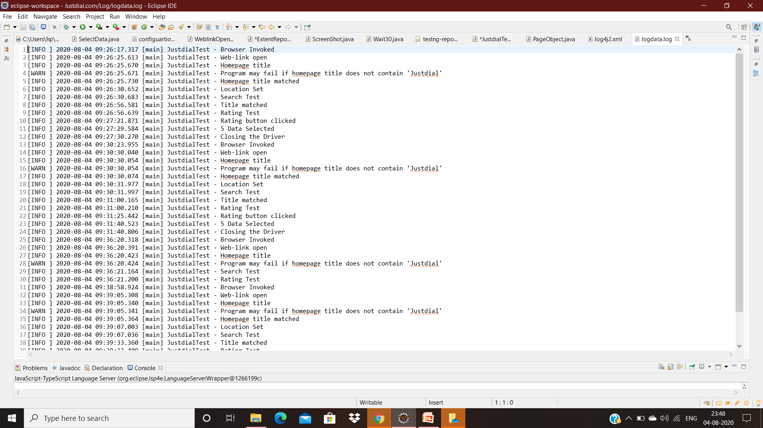
Logger

Slide 19
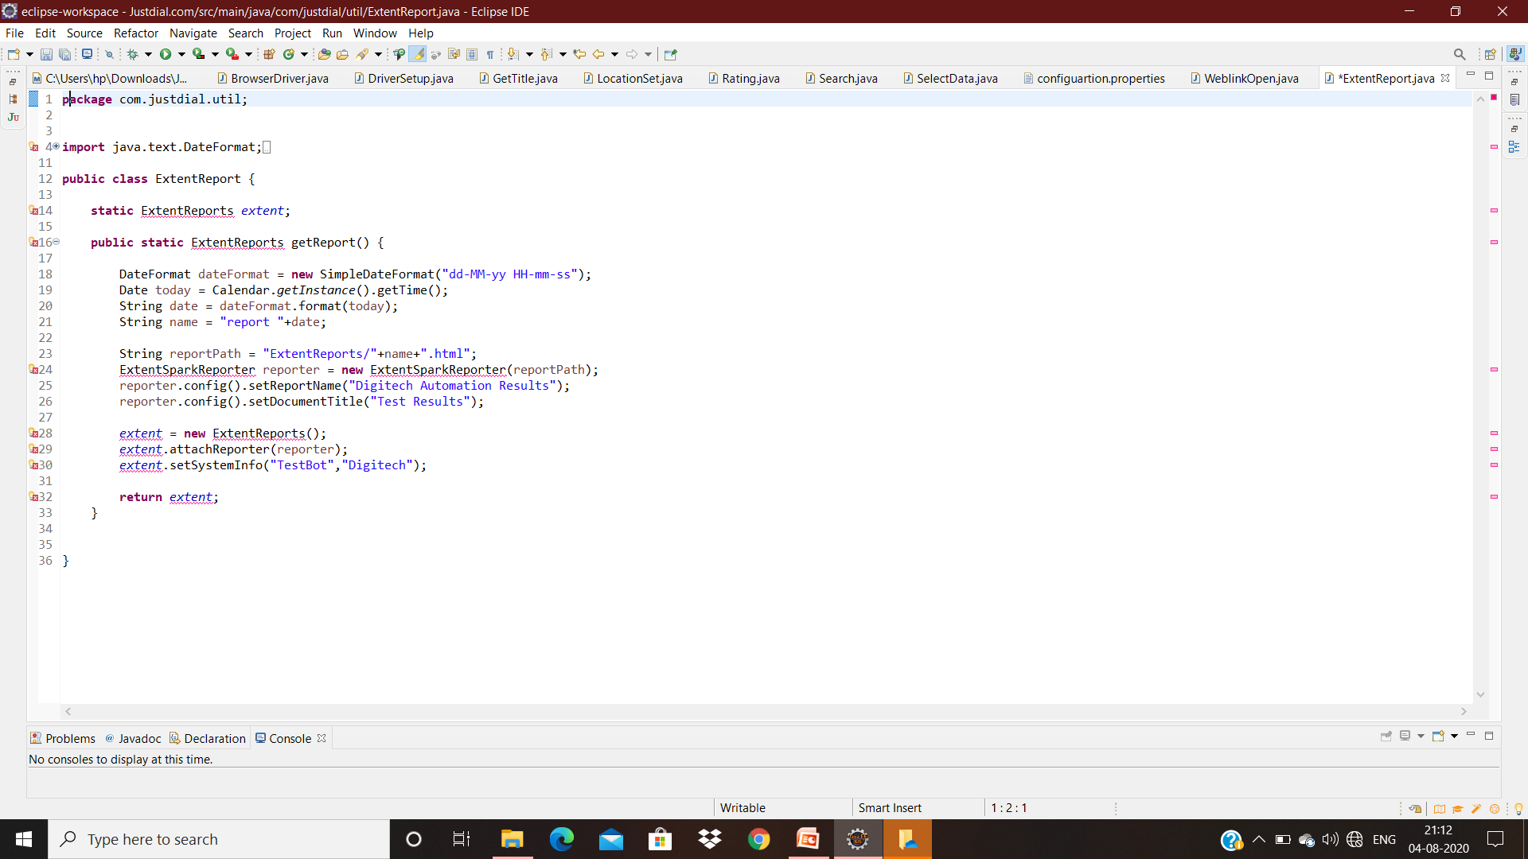
Utilities -Extent Report

Slide 20
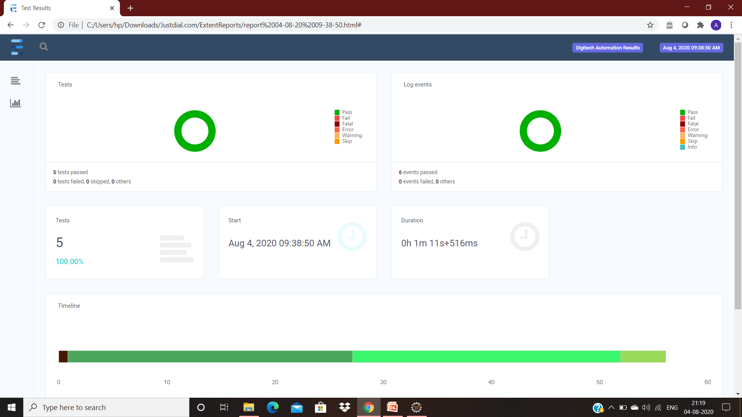

Slide 21
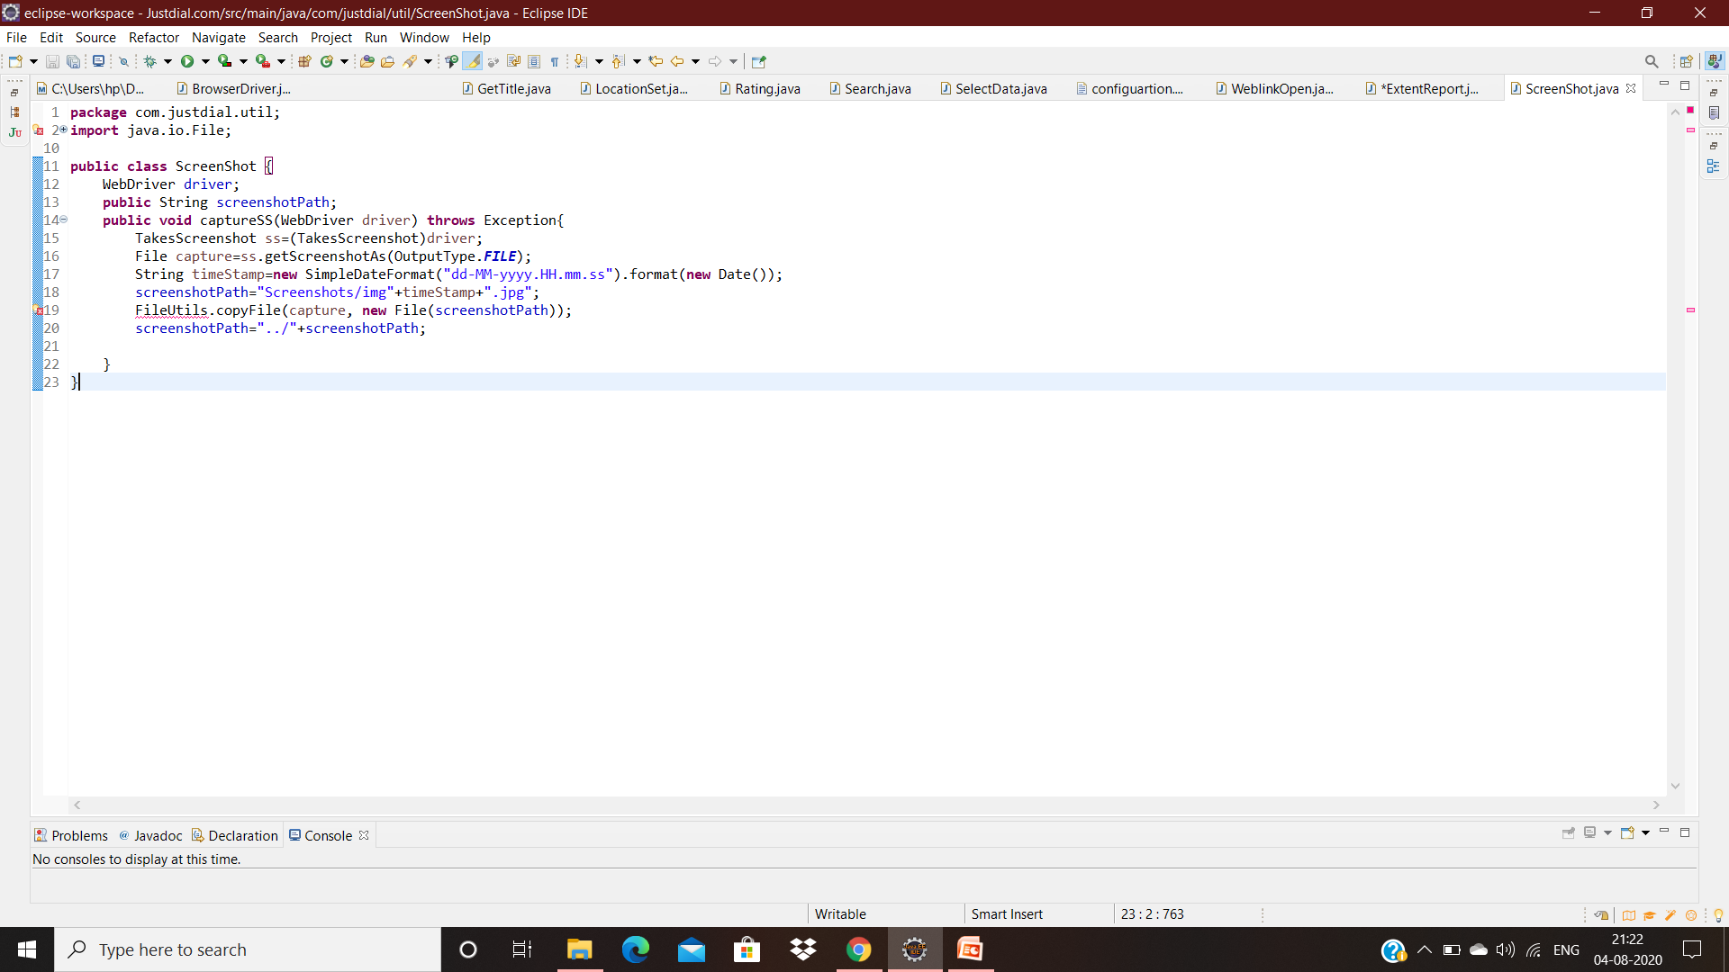
Screenshot

Slide 22
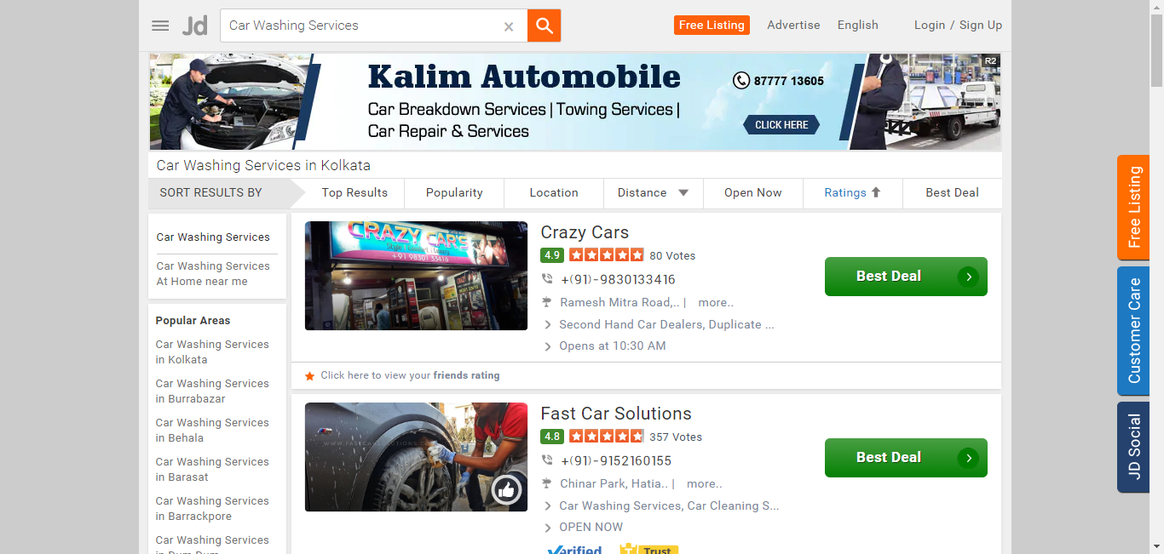

Slide 23
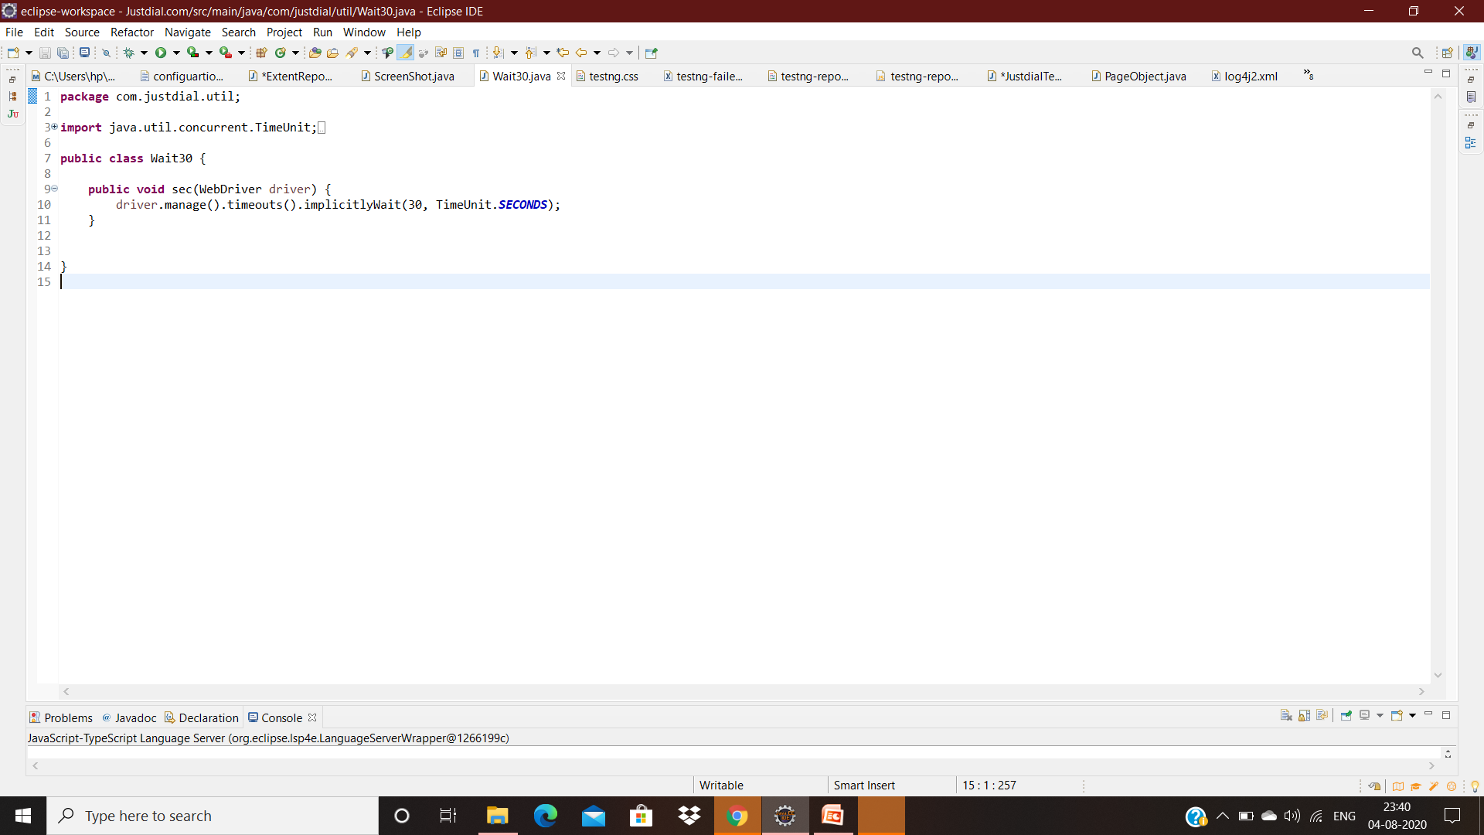
Wait30

Slide 24
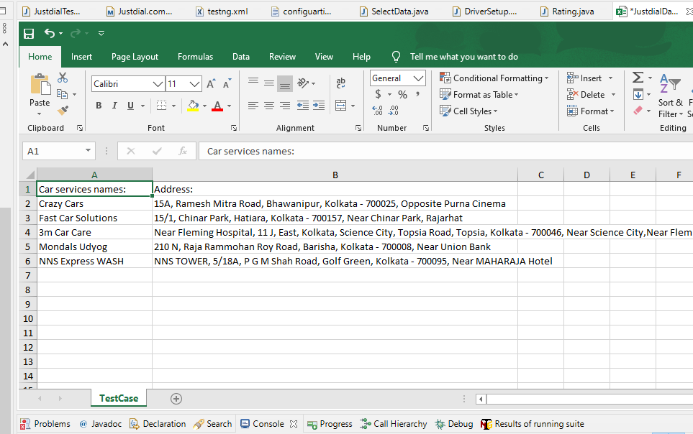
Output In Excel File

Slide 25
THANK YOUe

